Slide 1


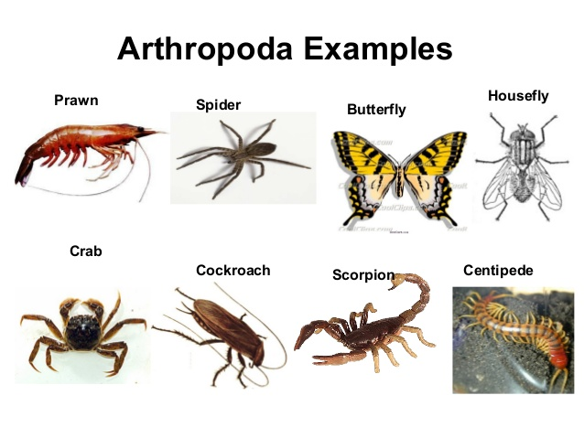
BASRAH UNIVERSITY
Faculty of Education for Pure Sciences
Biology Department
2025- 2026
Phylum: ARTHROPODS
SUBPHYLA: TRILOBITA, CRUSTACEA, CHELICERATA, AND UNIRAMIA
Presented By: Prof. Dr. Sabeeh H. AL-Mayah

Slide 2
Phylum Arthropoda “jointed feet”
Characteristics:
segmentation
Jointed, paire appendages
Exoskeleton – chitin
Cephalization
Compound eyes
Coelom
Open circulatory system
Ventral nerve cord

Slide 3
Number of species
Mollusca
Chordata
Platyhelminthes
Arthropoda
Nematoda
Porifera
Annelida
Echinodermata
Sarcomastigophora
Apicomplex
Ciliophora

Slide 4
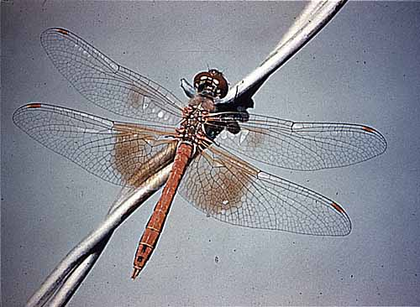
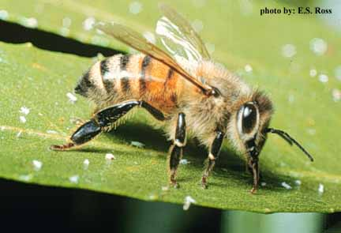
Arthropods Most Successful Animals
Number of species
Diversity
Distribution
Longevity
Reasons for Success
Versatile exoskeleton
Segmentation
Oxygen piped directly to cells (terrestrial)
Highly developed sensory organs
Complex behavior
Metamorphosis

Slide 5
The Arthropod Exoskeleton
Epidermis secretes an external skeleton called the exoskeleton.
The exoskeleton is composted of the polysaccharide chitin.
An arthropod can not grow without periodically shedding the exoskeleton. This process is called molting or ecdysis. During the few days following the replacement of the exoskeleton, the animal is extremely vulnerable and must hide from predators. There is also the problem of desiccation.
Advantages of possessing an exoskeleton:
provides strong support .
provides rigid levers that muscles can attach to and pull against.
offers protection.
serves as a barrier to prevent internal tissues from drying out; important because many arthropods live on land.
serves as a barrier to prevent infection.

Slide 6
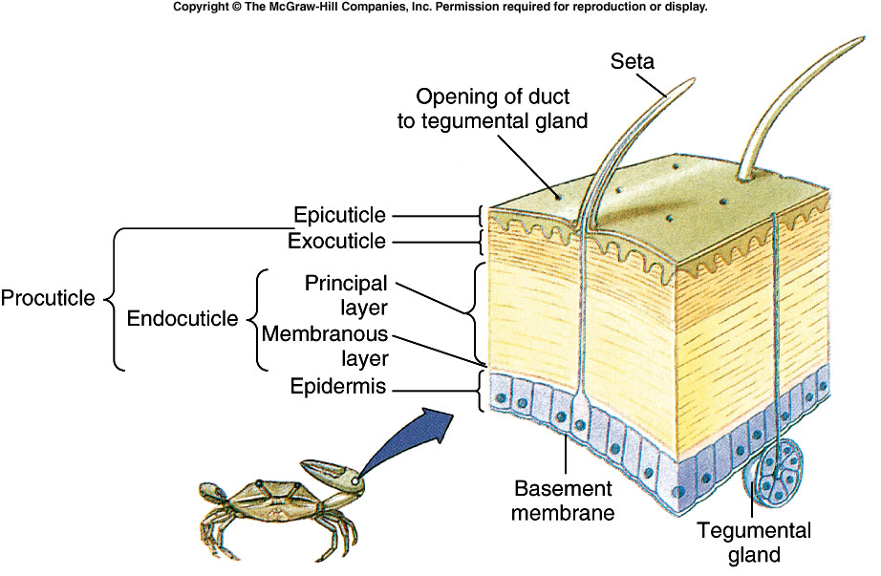
Advantages & Disadvantages of the Exoskeleton
Advantages
Protection
Support
Site for muscle attachment
Flexible at the joints
Disadvantages
Heavy
Growth limiting factor
Must be molted

Slide 7
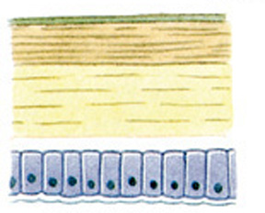
Structure of the Exoskeleton
Composed of the polysaccharide chitin and protein - glycoprotein
Outer surface called the epicuticle; contains waxes
The thicker portion is called the procuticle:
exocuticle
endocuticle
In the exocuticle, the glycoprotein chains are cross linked; process is called tanning
epicuticle
exocuticle
procuticle
endocuticle
epidermis

Slide 8
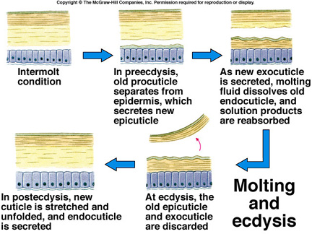
Molting
In order to grow the arthropod must shed its exoskeleton and secrete a new and larger one - molting or ecdysis.

Slide 9
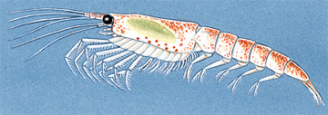
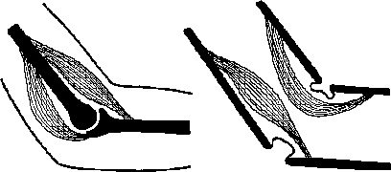
Jointed Appendages
Exoskeleton divided into several plates and cylinder.
At the junction point between plates and cylinders, the exoskeleton remains thin and flexible; these are the joints.
Jointed appendages allows arthropods to move efficiently and quickly
Muscles are integral to arthropod movement; they attach to the inner side of the exoskeleton; they often function as a lever system .
Arthropod joint
Vertebrate joint

Slide 10
Specialized Arthropod Segments: Reduction in Metamerism
The evolution of the arthropods witnessed a reduction in metamerism
The arthropods evolved modified groups of segments (e.g., segments became lost, some fused together .
The fusion of groups of segments into functional groups is called tagmatization .
In so doing, various appendages on segments became specialized for functions other than locomotion, e.g. prey capture, filter feeding, sensing various kinds of stimuli, gas exchange, copulation, etc.

Slide 11
Arthropod Respiratory Advances
Special respiratory structures allow the arthropods to metabolize more efficiently and thus move rapidly.
High metabolic rates require rapid oxygen delivery, and arthropods can accomplish this with respiratory organs that have a large surface area for collecting oxygen quickly.

Slide 12
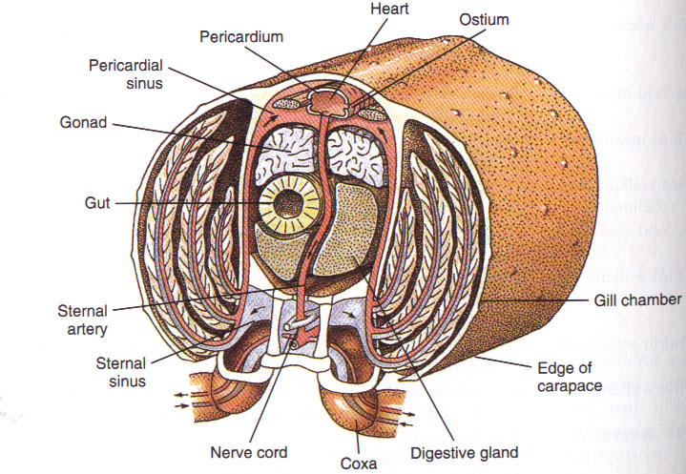
Gills
Many aquatic arthropods (crabs and lobsters) have gills, which are typically modifications of appendages or outgrowths of the body wall - folds of tissue with a large surface area.

Slide 13
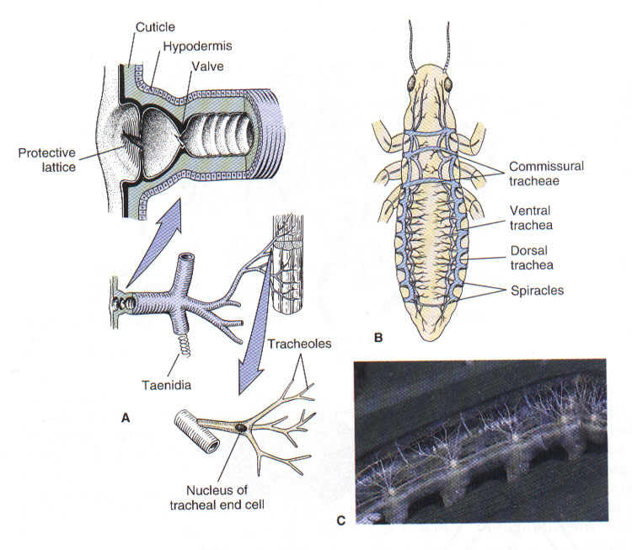
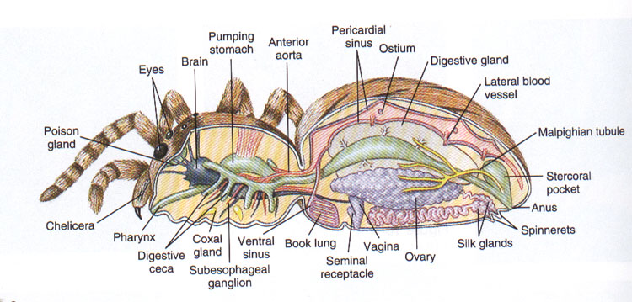
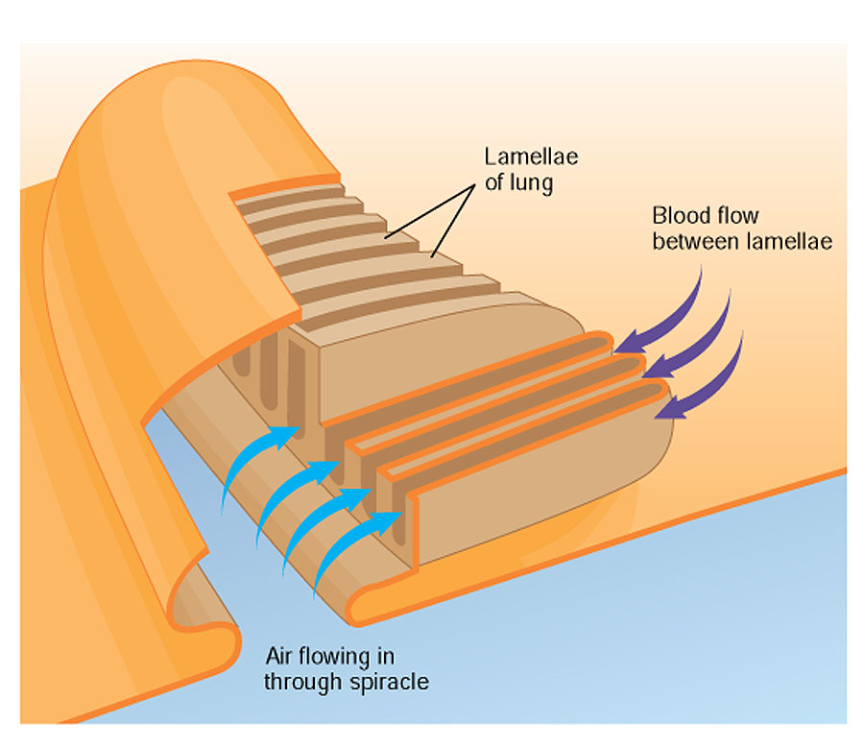
Tracheae
Gas exchange organs among terrestrial arthropods is usually internal invaginations of
The integument.
Insects have tracheae branching networks of hollow air conducting tubes such that air is sent to every cell in every tissue.
Book Lungs
Spiders have book lungs, chambers with leaf-like plates for exchanging gases; air flows over the plates and blood flows through them.

Slide 14
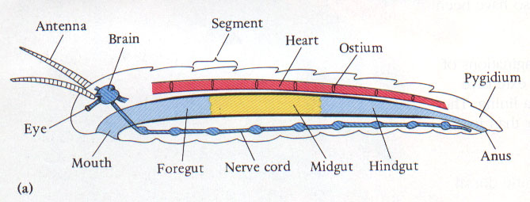
Acute Senses
Arthropods have a well-developed nervous system that is of the same overall design as the annelids; anterior brain and a double, ventral hollow nerve cord.
The sensory receptors of arthropods are usually associated with modifications of the chitinous exoskeleton.
The head usually bears various kinds of sense organs (e.g. antennae) with extreme sensitivity.

Slide 15
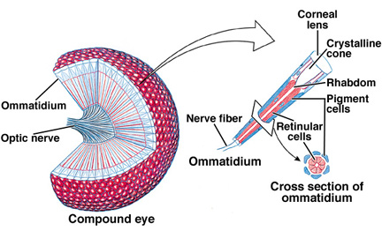
Acute Senses cont.
Many arthropods have compound eyes - eyes that are composed of many visual units called facets (ommatidia); capable of color vision and detecting the slightest movements of prey or predators.
Some eyes are simple eyes with only a few photoreceptors; however, they can form crude images.

Slide 16
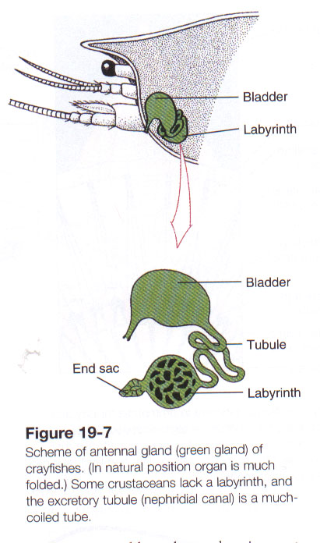
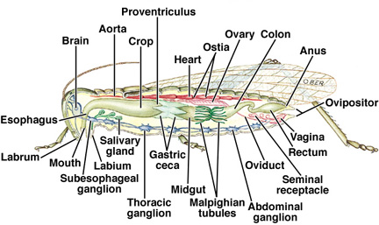
Internal Transport and Excretion
Open circulatory system .
Many crustaceans possess an excretory organ called the green gland (antennal gland), which filters fluid from the blood.
Most insects and spiders have an excretory system called Malpighian tubules.

Slide 17
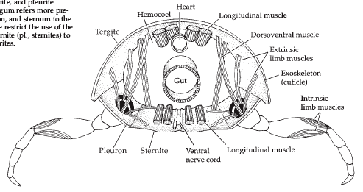
How do Arthropods support themselves and move?
Each segment bound by four plates - dorsal tergite, ventral sternite, and two lateral pleurites.
Muscle bands attach to apodemes.
Appendages segmented with extrinsic or intrinsic muscles.

Slide 18
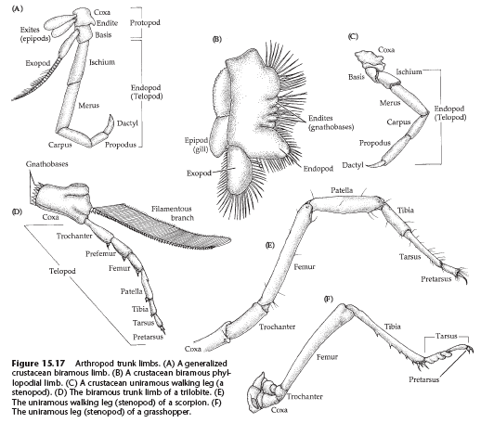
How do Arthropods support themselves and move?
Appendages:
Uniramous or biramous.
Parts are specialized for different tasks.

Slide 19
Arthropod Taxonomy: Overview
The arthropods evolved along four main lines, which most zoologists recognize as 4 distinct subphyla:
1. Trilobita - extinct trilobites.
2. Chelicerata - horseshoe crabs, spiders, ticks, mites, and some extinct groups.
3. Crustacea - crabs, lobsters, shrimps, barnacles.
4. Uniramia - insects, centipedes, millipedes.

Slide 20
Four Kinds of Arthropods
Trilobita
Uniramia
Arthropod
Chelicerata
Insects
Crustacean
Centipedes &
Millipedes
grasshopper
butterfly
crab
spider
beetle
lobster
scorpion
centipede
bee
barnacle
tick
millipede
moth
shrimp
mite
ant

Slide 21
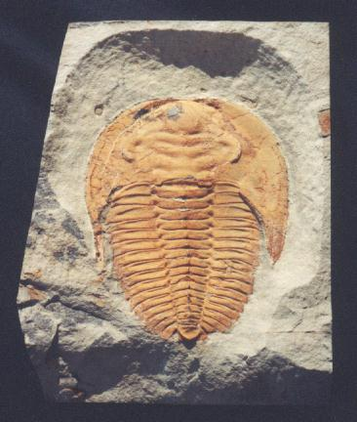
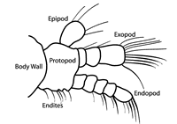
Subphylum Trilobita
Extinct
200 MYA
One pair of antennae
Biramous appendages

Slide 22
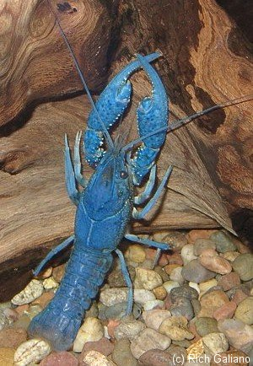
Subphylum Crustacea
Only arthropods with 2 pair of appendages on their head that serve as feelers .
Biramous appendages.
Most have 16-20 segments which are fused into several tagmata.
Most have gills for respiration.
Most have a free-swimming larva called a nauplius.

Slide 23
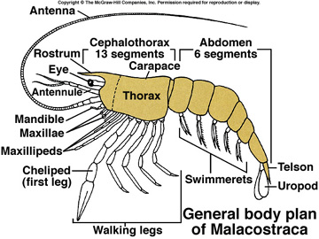
SubPhylum Crustacea
Possess 2 pair of antennae: First pair is homologous to those of insects; second pair is unique to the crustaceans
Second antennae have various functions, including sensory, locomotion or feeding.
The head bears a pair of compound eyes and 3 pairs of mouthparts: a pair of mandibles, and 2 pairs of maxillae; used for food handling .
Trunk varies considerably among classes
Primitively, the first three pairs of thoracic segments are maxillipeds; function in handling food
Also, there are usually 5 pairs of appendages strengthened for walking (walking legs) and protection (chelipeds, pincer-like claws)

Slide 24
Subphylum Crustacea cont.
Abdomen is also highly variable, but it is primitively large
Groups with a well-developed abdomen usually possess six pairs of appendages: Five pairs of structures called swimmerets (=pleopods); one pair of structures called uropods.
Uropods together with the terminal telson form a tail fan than can serve as rudders during locomotion.

Slide 25
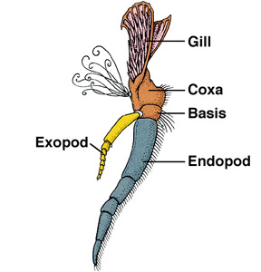
SubPhylum Crustacea cont.
Primitively many of the appendages of the crustaceans are biramous: there is an outer exopod and an inner endopod.
They usually have an extremely hardened exoskeleton, which is impregnated with calcium carbonate – carapace.

Slide 26
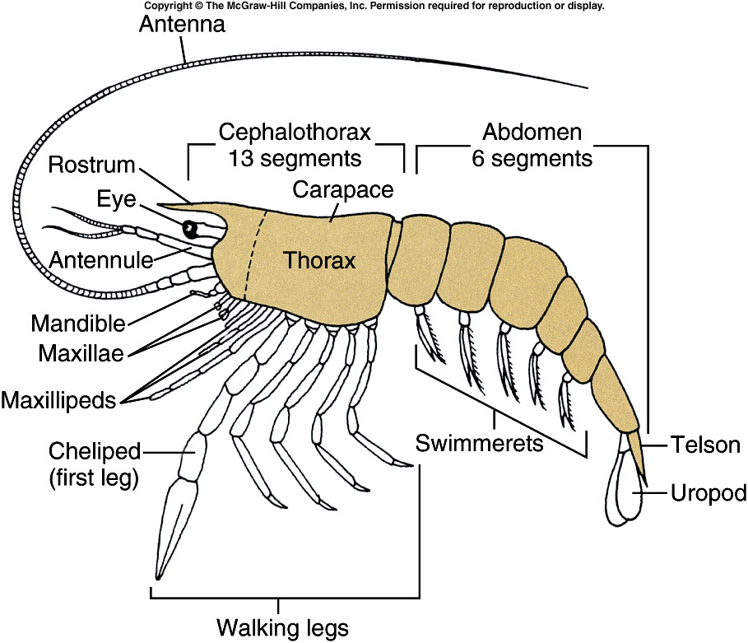
Notes:
Fig. 19.1

Slide 27
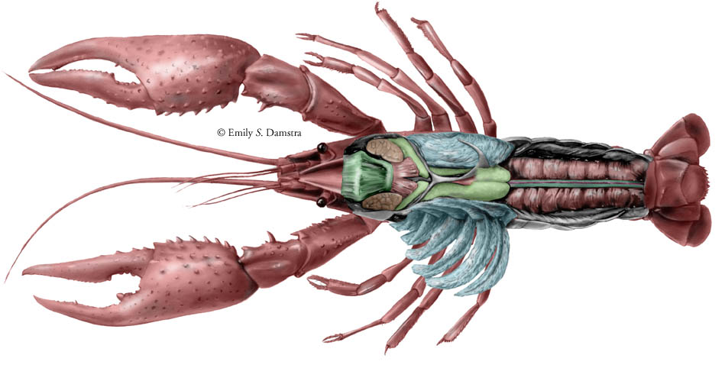
Crayfish

Slide 28
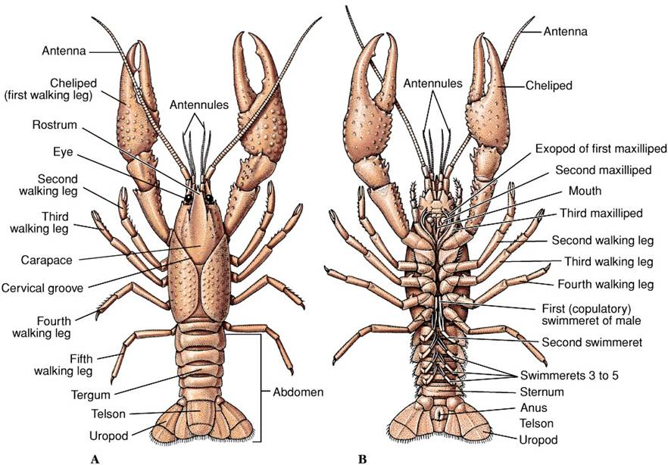
External Features of a Decapod
Notes:
Fig. 19.2

Slide 29
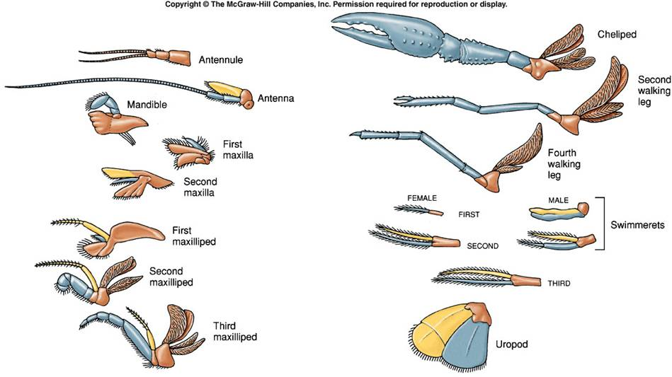
Parts are parts
Notes:
Fig. 19.4

Slide 30
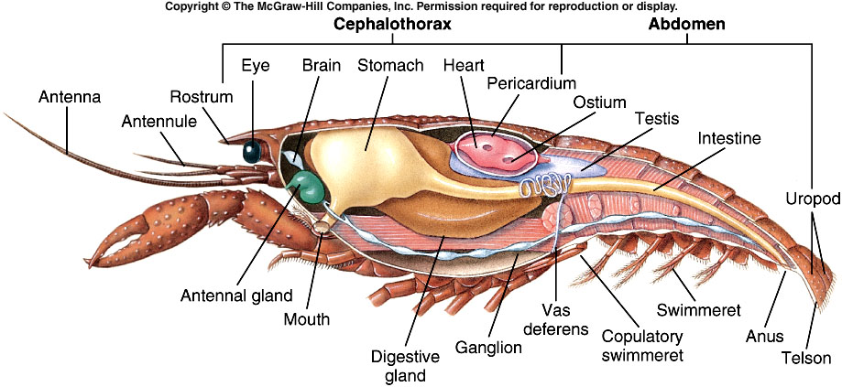
Decapod Internal Anatomy
Notes:
Fig. 19.5

Slide 31
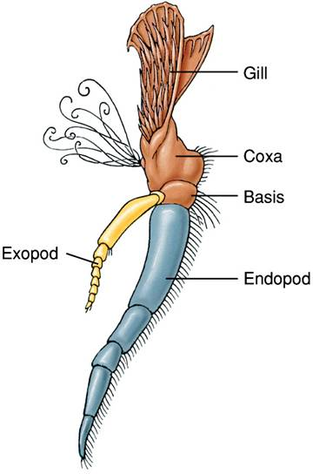
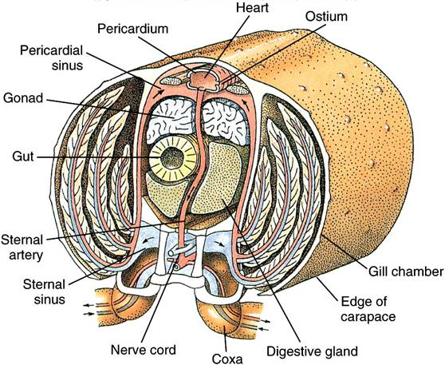
Circulatory & Respiratory Systems
Notes:
Fig. 19.3

Slide 32
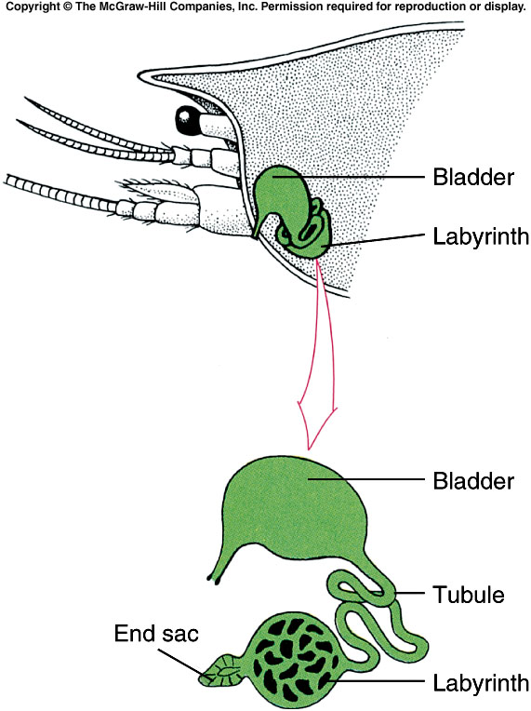
Excretory Systems
Notes:
Fig. 19.7

Slide 33
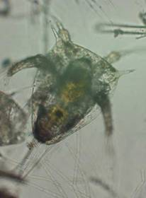
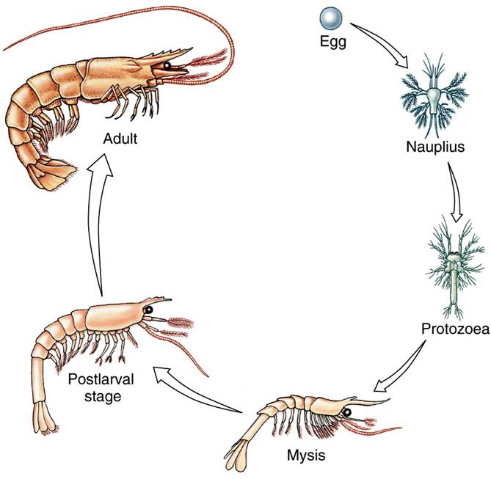
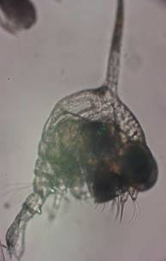
Crustacean Reproduction & Development
Notes:
Fig. 19.9

Slide 34
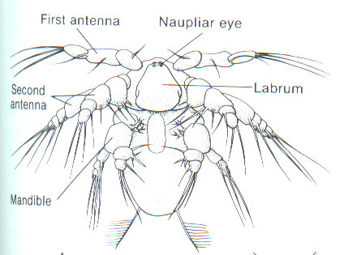
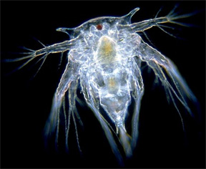
SubPhylum Crustacea cont.
The primitive larva of the crustaceans is called the nauplius larva
It has an unsegmented body, a frontal eye, and 3 pairs of appendages, representing the 2 pairs of antennae and the mandibles.

Slide 35
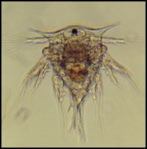
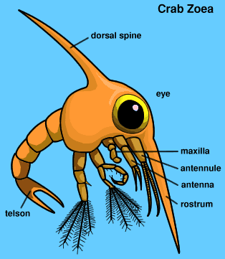
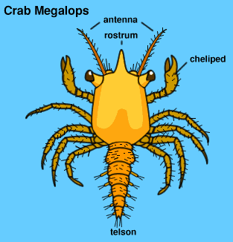
Arthropod Development
Nauplius
Zoea
Megalops

Slide 36
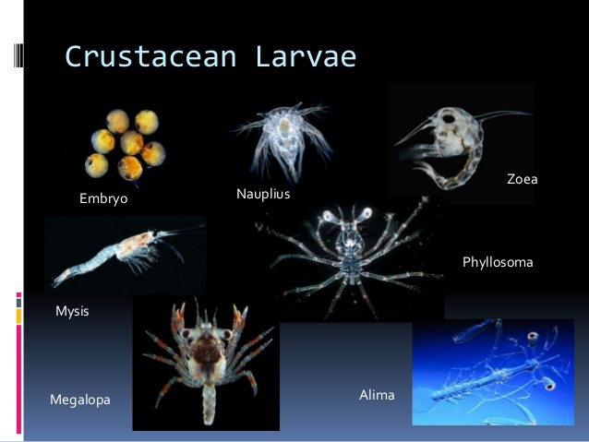

Slide 37
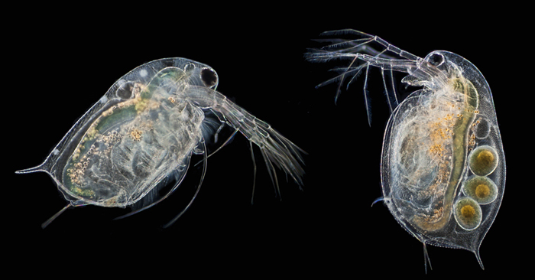
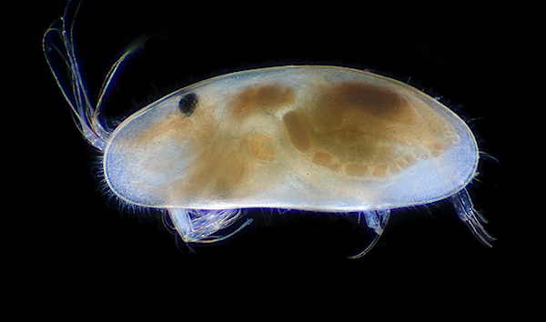
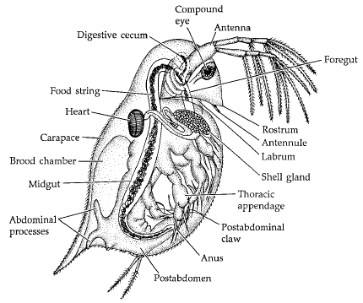
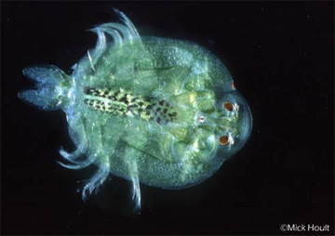
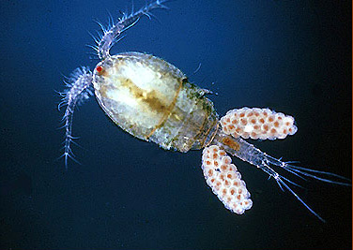
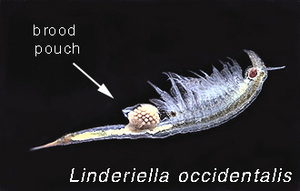
Crustacean Diversity Daphnia sp.
Water flea
Ostracod
Copepod Cyclops sp.
Fairy shrimp
Fish louse

Slide 38
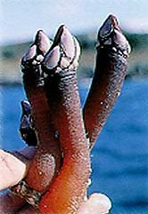
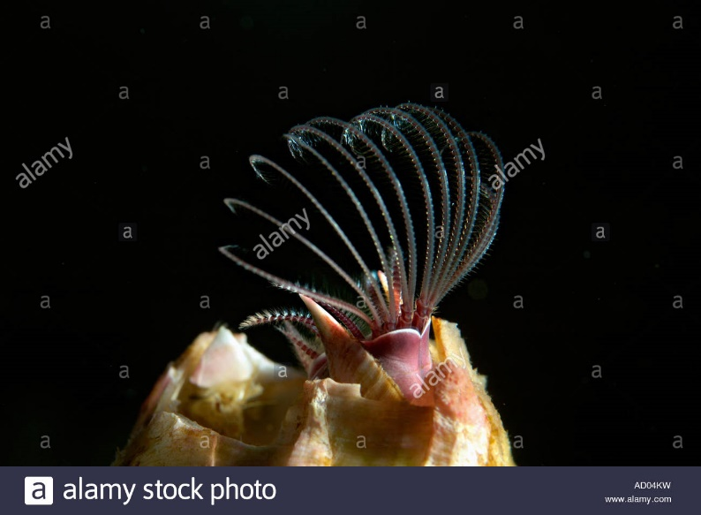
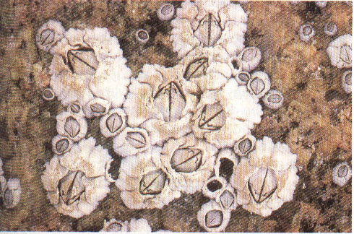
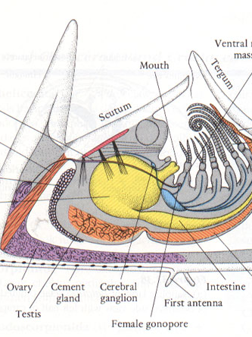
Barnacles are Crustaceans!

Slide 39

Fig. 19.24a
Notes:
Fig. 19.24a

Slide 40

Subphylum Chelicerata
Chelicerae
No antenna
No mandibles
4 pair of walking legs
1 pair of pedipalps

Slide 41
Class Arachnida
Include: spiders, scorpions, mites and ticks
Cephalothorax and abdomen.
Cephalothorax – 6 pairs of jointed appendages.
1 pair of chelicerae (used to inject venom into prey).
1 pair of pedipalps (holding food, chewing, & reproduction).
4 pairs of walking legs.
8 simple eyes at anterior end.
Spiders * Most spiders possess eight eyes (some have a few as two), but their image forming ability is limited.
*Hairlike setae, however, provide a lot of information about the environment sensing e.g. vibrations and air currents.

Slide 42
Spiders
All spiders are predators and their chelicerae function as fangs.
The fangs are connected via ducts to venom glands that produce a lethal venom the spider uses to dispatch its prey.
After killing a prey item, the spider injects digestive fluid into the organism and sucks up the resulting soup.
Abdomen - Execratory organs
Spinnerets * Malpighian tubes
Respiration * Coxal glands
Book lungs
Tracheae and Spiracles .

Slide 43

Notes:
Fig. 18.5

Slide 44

Arachnid Body Regions
Notes:
Fig. 18.4

Slide 45
Reproduction in spiders
Courtship rituals are a major feature of spider mating in which the (usually much smaller) male attempts to mate without being eaten by the female.
Males produce a sperm packet wrapped in silk which he holds in a cavity in one of his pedipalps (second pair of appendages).
The male, if he lives long enough, inserts a pedipalp into a female’s genital opening and she stores the sperm in a seminal vesicle.
The female later fertilizes eggs when she is ready to lay them. Eggs are laid in a silk cocoon where the young hatch and remain for a short time and molt before departing for an independent life.

Slide 46


Brown Recluse Bite Victom

Slide 47
Subphylum Chelicerata: Order Scorpionida: Scorpions
There are about 1,500 species of scorpions and the group includes some of the largest of the arachnids as some scorpions reach up to 18cm in length.
Scorpions are best known for their prominent front claws, which are modified pedipalps and their stinging tail, with which they inject venom.
Scorpions have a body that consists of a quite short cephalothorax, which bears 4 pairs of walking legs and a long, segmented abdomen which is divided into a thick preabdomen and a thinner postabdomen that carries the stinging apparatus.

Slide 48



Giant desert hairy scorpion

Slide 49

Scorpions glow when a black light (UV light) is shone on them. This is because the cuticle contains a variety of fluorescent compounds.
This characteristic makes nocturnal surveys of scorpions quite easy.

Slide 50
Scorpions
Scorpions occur on all continents except Antarctica.
They are commonest in tropical and subtropical areas, but some occur in colder areas including high mountain tops. Scorpions are generally secretive and hide from potential predators during the day in crevices before emerging to feed at night on insects and similar prey. The largest species may kill small reptiles and mammals.
Prey is gripped with the pincers (pedipalps) and either crushed or stung to death. Scorpions consume only liquids, so the prey is torn into tiny pieces using the jaw like chelicerae and predigested in a pre-oral cavity below the chelicerae until it liquifies and is then consumed.
Scorpion’s liking for dark places to hide is why it’s important to shake out your shoes in the morning in scorpion country.

Slide 51
Scorpions are viviparous (give birth to live young) and these stay with their mother and ride on her back until they undergo their first molt. They depend on their mother for protection and to regulate humidity levels.
The young go through 5-7 molts (instars) before reaching maturity.

Slide 52
3 Types of Birth in Scorpions
Oviparous – females lay eggs that develop outside of body.
Ovoviviparous – young develop in large, yolky eggs held internally in body, then are born, fully developed.
Viviparous – mother provides nutrients to embryos; eggs develop in special chambers close to female digestive tract. After birth, young crawl onto mother’s back for about 1 month.

Slide 53


Class Merostomata
Limulus
Dates to back to Triassic
245 MYA
Carapace
Telson

Slide 54

Why are horseshoe crabs called “living fossils?”
They remain unchanged after 220 million years!
Notes:
Fig. 18.2a

Slide 55

Notes:
Fig. 18.2b

Slide 56

SubPhylum Uniramia
Single pair of antennae
First pair of feeding appendages are mandibles
There are one or 2 pairs of maxillae
Number of legs vary from 3 pair to many pairs; they are unbranched or uniramous.

Slide 57

Class Chilipoda (Centipedes)
Serial segmented, flattened body and each segment has a pair of jointed appendages
Active predators, killing their prey with poison claws, which are modified legs on first segment

Slide 58


Class Diplopoda (Millipedes)
Serially segmented, rounded body with 2 smaller pairs of legs per segment
Slow moving; feed on decaying plants

Slide 59

Class Insecta
Body is divided into 3 parts: the head, thorax and the abdomen.
* Head has one pair of antennae, a pair of compound eyes and several sets of simple eyes
Mouthparts: a pair of mandibles, and two pairs of maxillae
One pair of maxillae are fused together to form a lower lip - labium
An upper lip - labrum - formed from an extension of the head

Slide 60
*Thorax Wings - most insects have wings .However ,not all insects with wings can fly. Wings are attached to the thorax region of an insect's body. Insects have 4 wings(2 wings on each side of their body). Six legs- Insects have 6 legs. Their legs are attached to the thorax region of their body. *Abdomen The basic number of abdominal segments in insects is 11plus a telson which bears anus. On eight and nineth segment of female and nineth segment of male, the appendages are modified as external organs of reproduction or genitalia.

Slide 61


Mouthparts are highly modified depending on the group you are discussing
Mosquitoes have pointed mouthparts for piercing and sucking; grasshoppers have mouthparts that are well adapted for chewing; butterflies for siphoning; flies for sponging

Slide 62

The End

